Slide 1
Slow-Reveal Data (1)

Slide 2
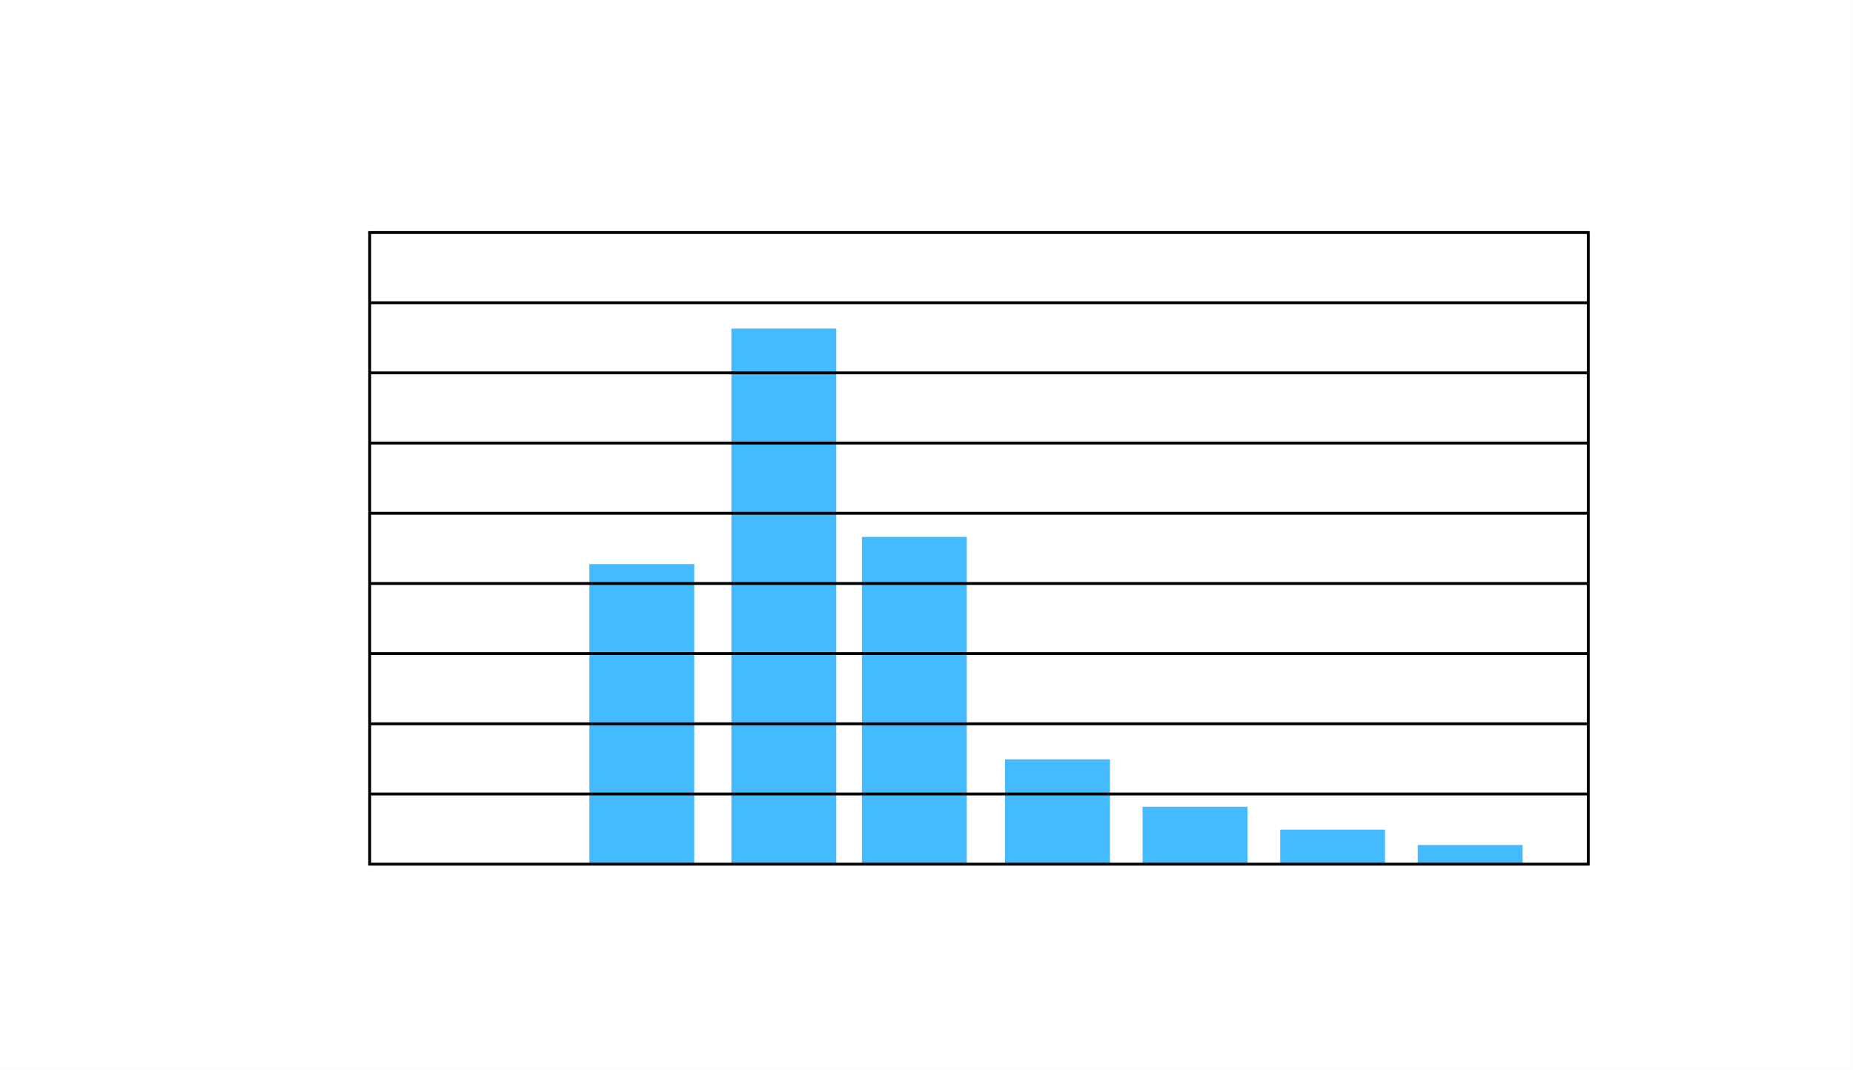
Notes:
What do you notice?
What do you wonder?

Slide 3
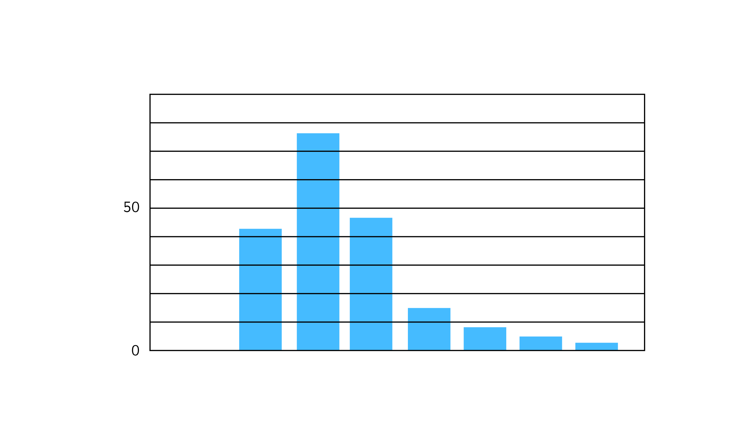
Notes:
What new information did we just learn?
How does that change your thinking about the graph?
What values can you estimate now?
What do you think this graph might be about?

Slide 4
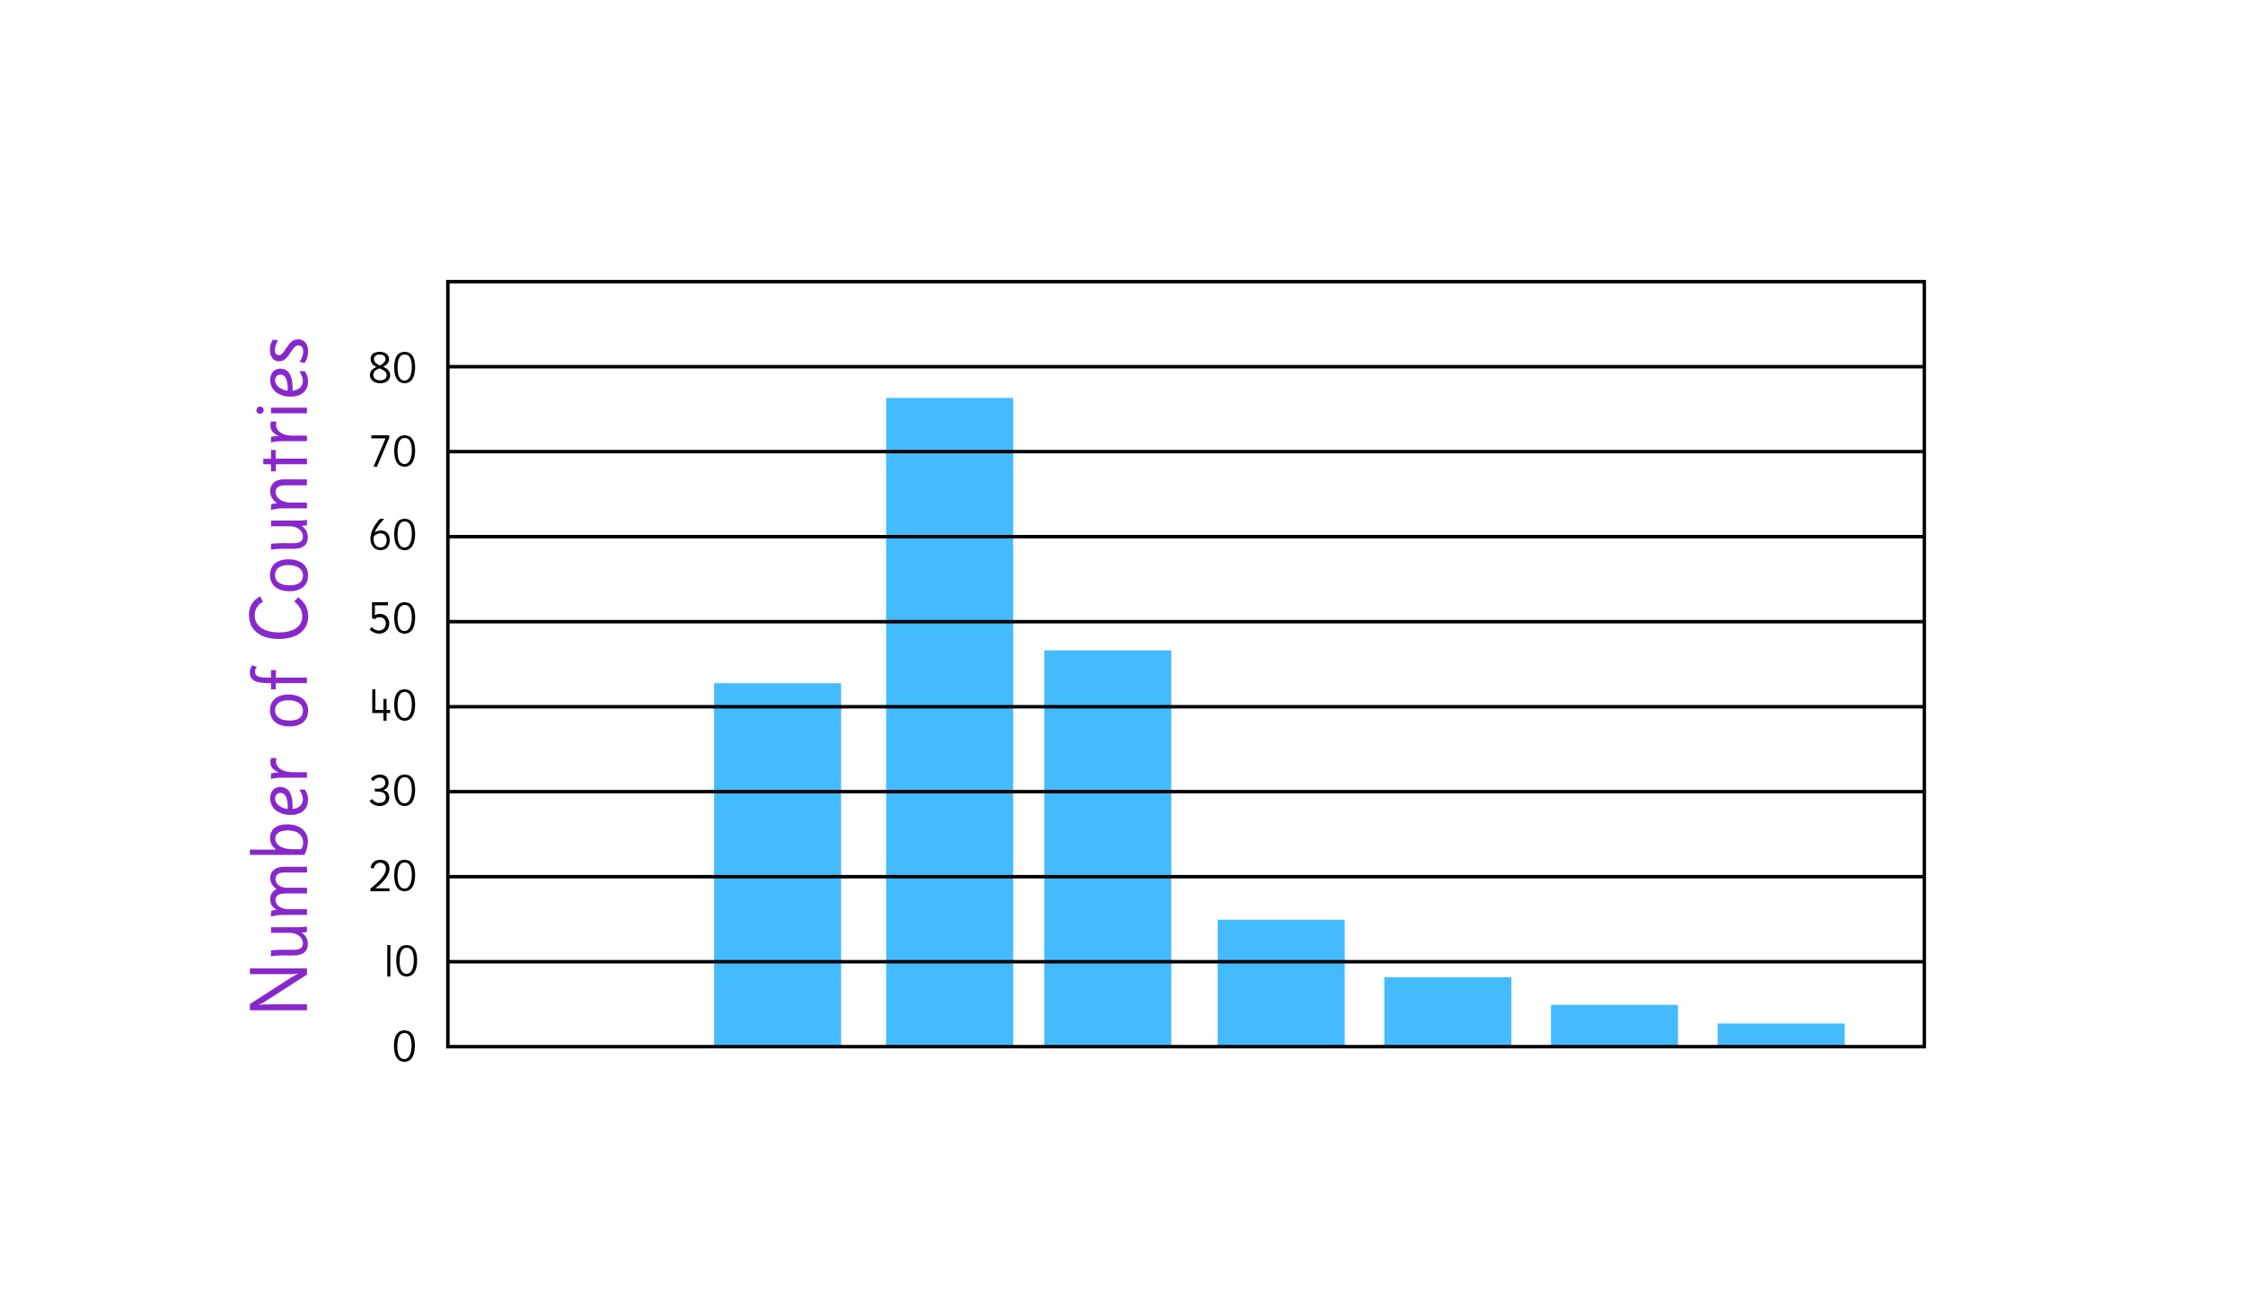
Notes:
What new information did we just learn?
How does that change your thinking about the graph?
What values can you estimate now?
What do you think this graph might be about?

Slide 5
Notes:
What new information did we just learn?
How does that change your thinking about the graph?
What values can you estimate now?
What do you think this graph might be about?

Slide 6
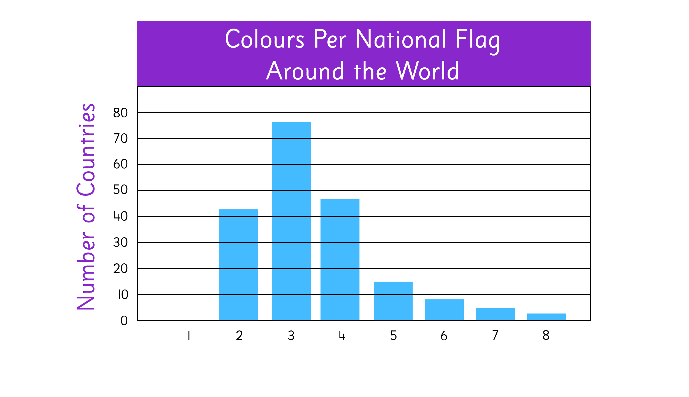
Notes:
What new information did we just learn?
Are you surprised? Why or why not?
What would you label the x-axis (horizontal axis)?

Slide 7
Notes:
What new information did we just learn?
What’s the most popular number of colours?
About how many more flags have 3 colours than 4 colours?
Can you name a country with a flag that has 2 colours? …3? …7 or 8?

Slide 9
Notes:
What is the same about this representation? What is different?
Do you think the creators of these two graphs used the same data source? Why or why not?

Slide 10
Notes:
What is the same about this representation? …different?
Do you think the creators of these two graphs used the same data source? Why or why not?

