Slide 1
Data Investigation Cycle

Slide 2
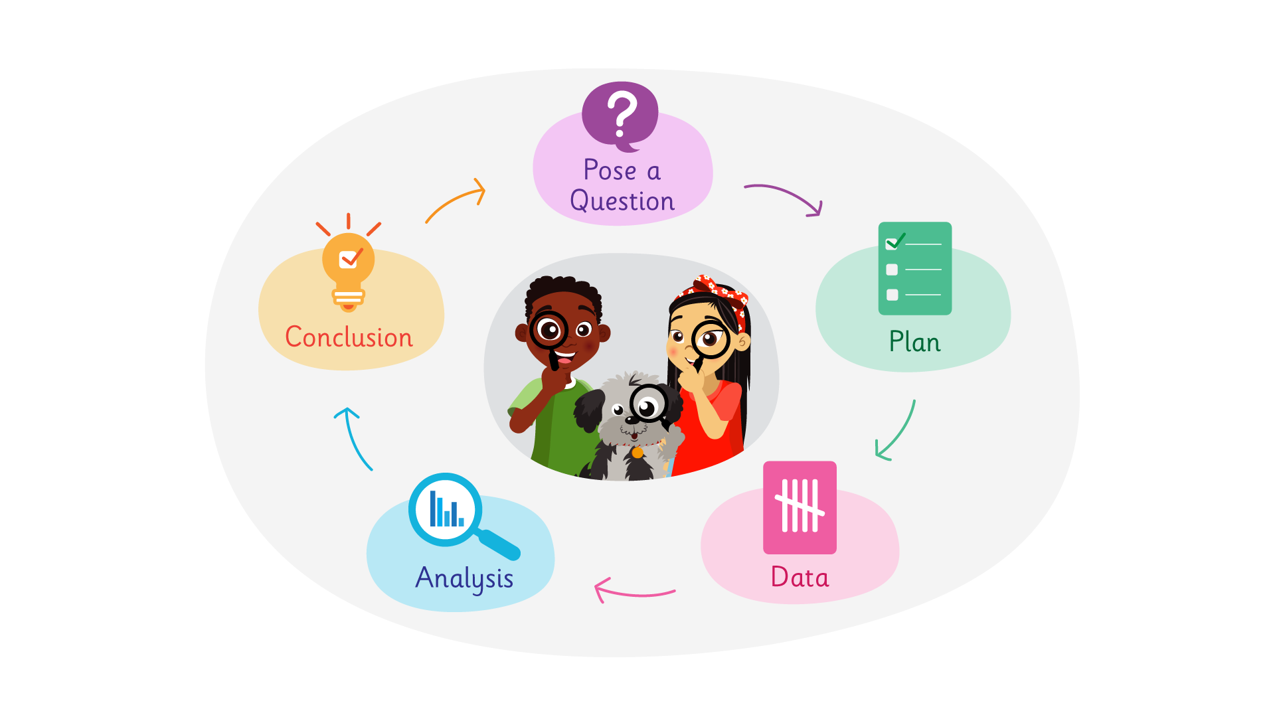
Data Investigation Cycle

Slide 3
Pose a question
What do we want to find out?
What is the question we want to answer?
Is it an interesting question?
Is it an answerable question?
Is it worth answering?
How will we find out the answer?

Slide 4
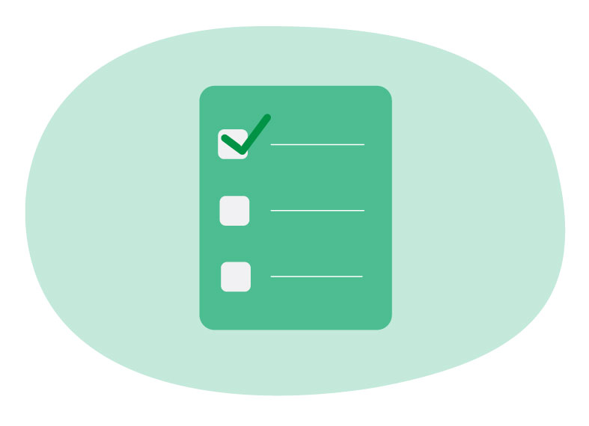
Plan
How can we find out? What should we do?
What data do we need to collect?
Who should we collect it from?
Who will collect the data? Where? For how long?
How will we record and organise the data?
What do you think we will find out?

Slide 5
Data
Collect the data as planned.
Is the collected data organised?
Is the collected data clear and easy to read?

Slide 6
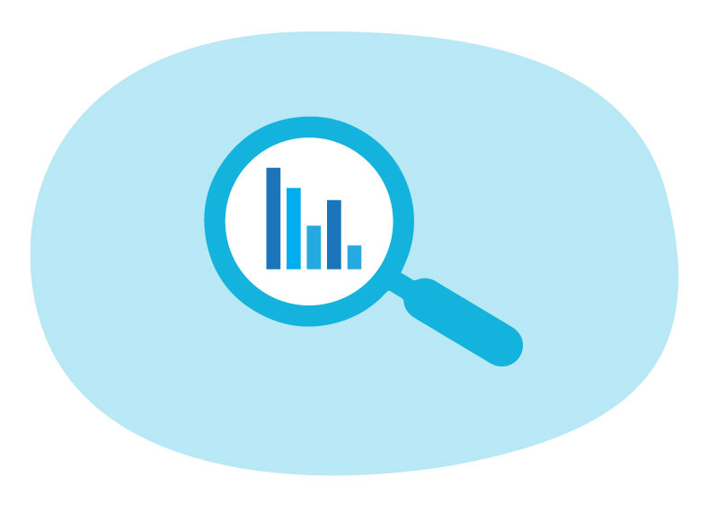
Analysis
Look at the data carefully. What do we notice?
What are the greatest and least values?
How might we display the data for others?
What graph (and scale) would be most suitable?
What title? Labels? A key?
Describe the shape of the data; what does it tell us?

Slide 7
Conclusion
What are our findings? What do they tell us?
Have we answered the original question?
What is interesting or surprising about the findings? Any patterns?
Who might be interested in this information? Explain why.
How could the findings be shared with a wider audience?
Do we have any unanswered or new questions?

